Slide 1
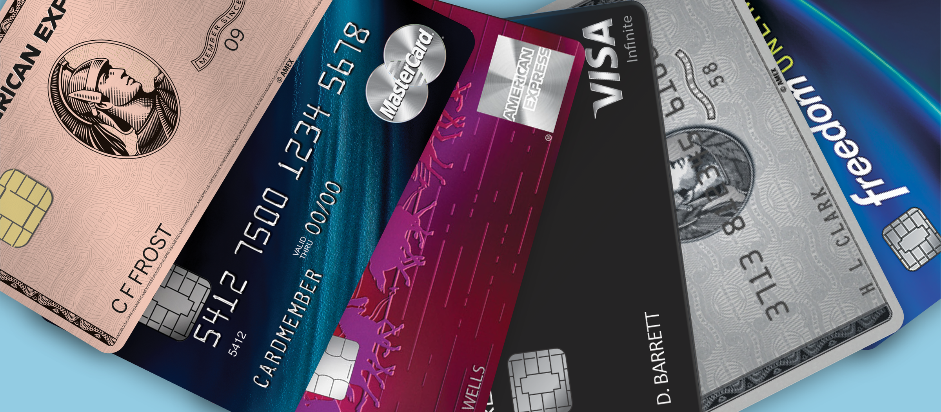
Bank Credit Card Launch Strategy

Slide 2
Introduction
Mitron Bank is a well-established financial institution with a long history of serving customers.
The bank’s main headquarters is located in Hyderabad, a major city in India.
Mitron Bank aims to expand its product offerings in the financial market.

Slide 3
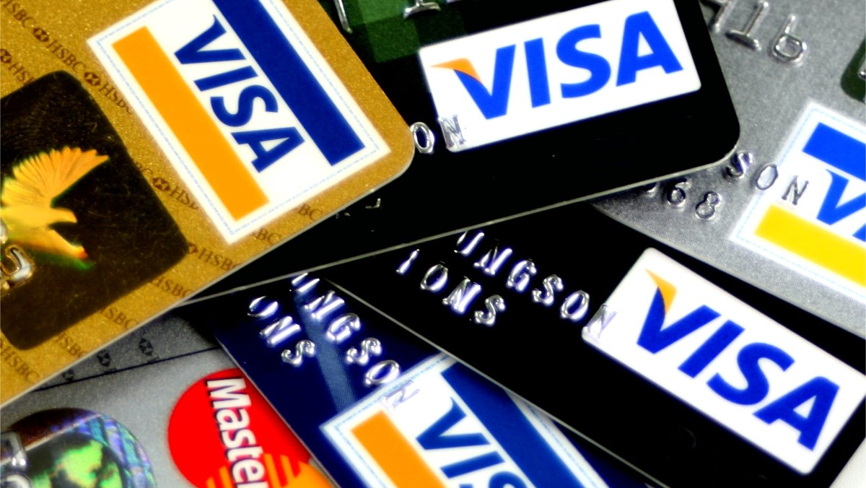
Dashboard Overview
Demographic classification: Classify the customers based on available demography such as age group, gender, occupation etc. and provide insights based on them.
Spending Analysis :Where do people spend money the most? Does it have any impact due to occupation, gender, city, age etc.? This can help you to add relevant credit card features for specific target groups.
Avg income utilisation %: Find the average income utilisation % of customers (avg_spends/avg_income). This will be your key metric. The higher the average income utilisation %, the more is their likelihood to use credit cards.
Key Customer Segments: By doing above, you should be able to identify and profile key customer segments that are likely to be the highest-value users of the new credit cards. This includes understanding their demographics, spending behaviours, and financial preferences.
Credit Card Feature Recommendations: Provide recommendations on what key features should be included in the credit card which will improve the likelihood of credit card usage. This should be backed by the insights from data provided and also some secondary research on the internet for this.
This Photo by Unknown Author is licensed under CC BY-SA

Slide 4
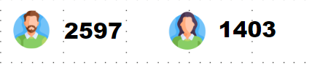
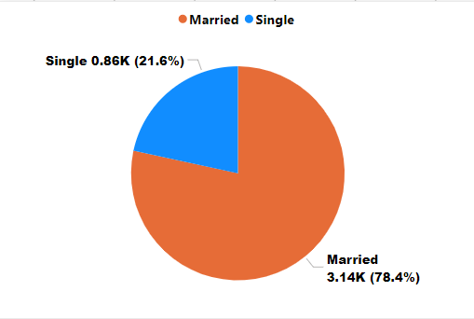
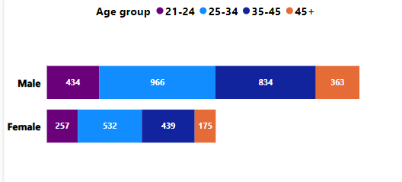
Demographic Analysis
Total Customers: The dataset encompasses a substantial pool of 4000 customers, forming the foundation of our analysis.
Gender Distribution
* Total Male Customers: 2597 (64.93%)
* Total Female Customers: 1403 (35.08%)
Customers by Marital Status
Married customers dominate the landscape, constituting a substantial 78.41% of the total customer base (3136 customers).
Unmarried customers account for 21.6%, totaling 864 individuals.
Customers by Age Group & Gender
The age group 25-35 emerges as the dominant segment with 1498 customers, comprising 966 males and 532 females.
Following closely, the age group 35-45 commands 1273 customers, demonstrating a nuanced breakdown of 834 males and 439 females.
Notably, the 45+ age group exhibits the smallest customer count, standing at 538.

Slide 5
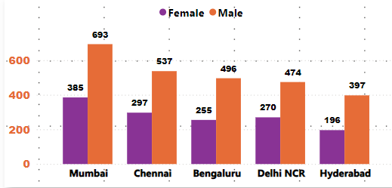
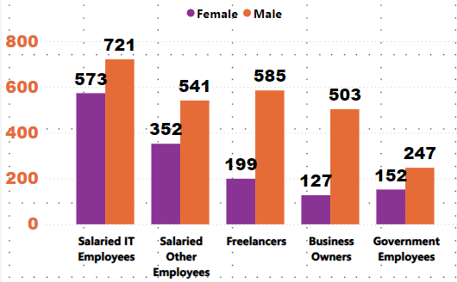
Demographic Analysis
Customers by City:
Mumbai leads with the highest number of customers, totaling 1,078. This includes 693 males and 385 females.
Chennai has 834 customers, Bangalore has 751, Delhi NCR has 744, and Hyderabad has 593.
Customers by Occupation:
Salaried IT Employees are the largest group, with 1,294 customers, consisting of 721 males and 573 females
Other notable categories are Salaried Other Employees with 893 customers, Freelancers with 784, Business Owners with 630, and Government Employees with 399.

Slide 6
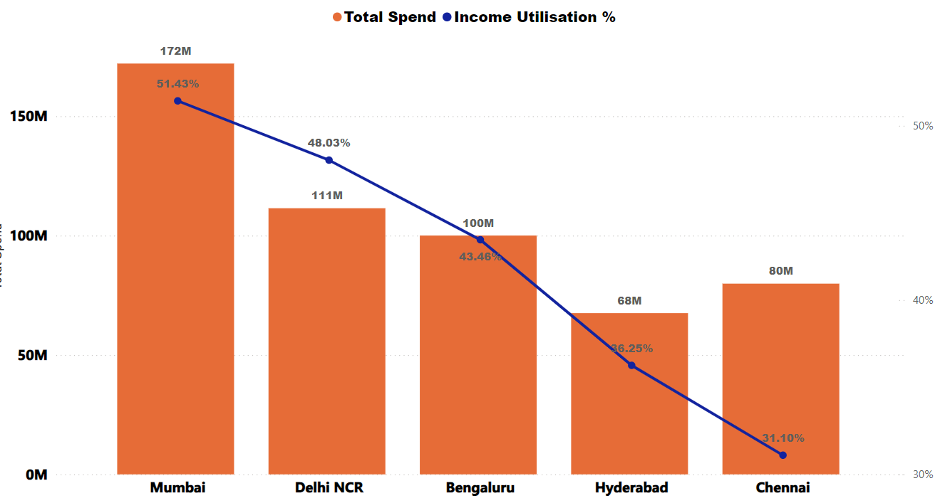
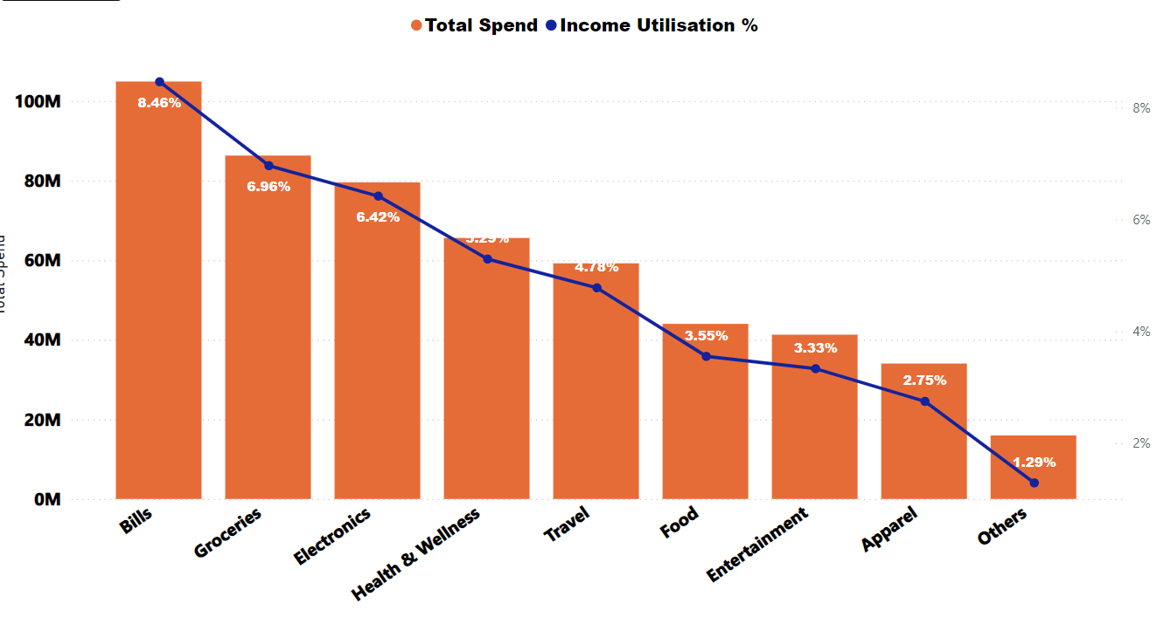
Spending Analysis
Total Spend, Income Utilization by City:
Mumbai outshines with the highest income and spend, resulting in a utilization rate of 51.43%.
Following Mumbai Delhi is the second highest spending city and having a utilization rate of 48.03%
Total Spends & Income Utilization by Category:
Highest spending in bills category (105M).
Other significant categories: Grocery (86M), Electronics (80M), and the least in Others category (16M).

Slide 7
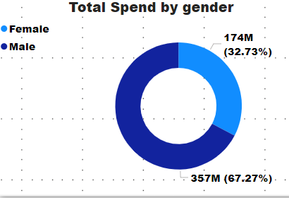
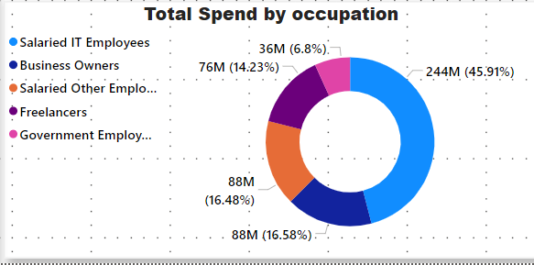
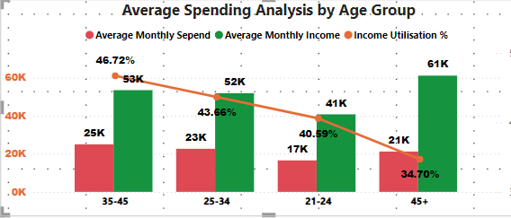
Spending Analysis
Total Spend by Gender:
Males are predominantly Spending with the majority distribution of 67.2%
Total Spend, Utilization by Occupation:
Salaried IT Employees and following them Business owners ,& Salaried other Employees should be focused
Income, Spend, Utilization by Age Group:
Age Group 35-45 , 25-34 are the one who has majority Utilization of income that means they spend more and bank can target them first

Slide 8
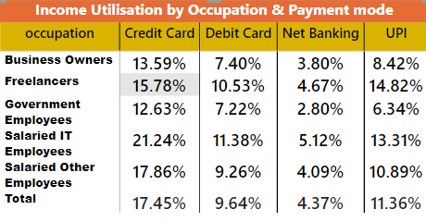
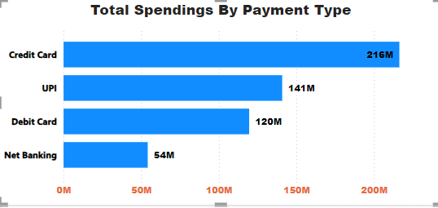
Payment Mode Analysis
Total Spendings by Payment Mode:
Credit cards dominate spending, accounting for 216M with a utilization rate of 17.45%.
Following Credit Cards UPI is the Payment Mode used by Population , UPI is the Competition for credit card payment mode
Income Utilization by Occupation & Payment Mode
We can clearly see that salaried IT Employees , Salaried other employees mostly used Credit card for payment mode and their second best payment mode is UPI

Slide 9
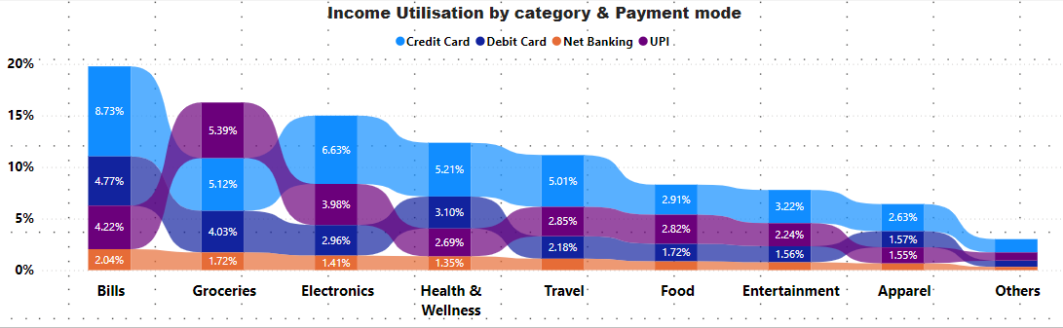
Payment Mode Analysis
Income Utilization By category & payment Mode
We can clearly see Bills is the category where people spend maximum of their income and use credit card payment mode maximum .
Credit card is used in almost all categories except Groceries , Due to the ease of UPI People Prefer UPI Payment Mode for grocery shopping

Slide 10
Age Group Insights & Recommendations
Insights
The 25-34 and 35-45 age group showcases a strong inclination for credit card utilization.
To enhance the likelihood of credit card usage, especially among the target audience of individuals aged 25-40 who spend and earn more, consider incorporating the following key features into your credit card offerings
Recommendations
Offer cashback, points, or miles for every transaction, encouraging users to use the credit card for everyday expenses.
A credit card with low or no annual fees is more attractive to potential users.
Provide higher credit limits to accommodate the spending patterns and financial capacity of the target audience.
Offer attractive sign-up bonuses, such as bonus points or cash rewards upon card activation, to incentivize new users.

Slide 11
Spending Category Insights & Recommendations
Insights
Substantial spending in bills, groceries and electronics
Recommendations
Enhance rewards for key spending categories by introducing dynamic cashback rates, loyalty points, or partner discounts, giving cardholders a strong incentive to use their credit cards more often.
Establish strategic partnerships with well-known brands to offer exclusive discounts, early access to sales, or special financing options for products in popular spending categories. Additionally, partner with utility companies to provide exclusive discounts or cashback for bill payments made with the credit card.
Work with grocery chains and electronics retailers to deliver special promotions or discounts for cardholders.
Extend warranties on electronic purchases to add further value.

Slide 12
Occupation Insights & Recommendations
Insight
Salaried IT employees, Freelancers, and Salaried Other Employees represent a significant user base with notable spending patterns.
Recommendation: To enhance credit card usage among these target groups, consider integrating the following features into the credit card:
Targeted Rewards: Create specific reward categories that match the spending habits of IT professionals, such as for technology purchases, software subscriptions, and online services.
Travel Perks: Offer travel-related benefits like airport lounge access, travel insurance, and discounts on flights or hotel bookings, catering to the frequent travel needs of IT professionals.
Exclusive Partnerships: Collaborate with popular brands or retailers to provide cardholders with unique discounts, promotions, or special offers.
Extended Grace Period: Implement an extended interest-free grace period, especially for business-related expenses, allowing users more time to pay off their balances without accruing interest.

